Slide 1
U-boot

Slide 2
Bootload
What is bootloader
Bootloader is the first execute program on SOC (?)
Boot : short bootstrap
  Initialize basic of SOC (CPU, RAM, CLK)
Down loader
  Download Image or Application to ram from host (developer host PC)
Loader
  Load OS to ram form volatile memory

Slide 3
All kinds of embedded Linux bootloader
U-boot
UEFI
Redboot
Stubby (Linaro) …
Anyway, they are same target
  Load and boot OS to RAM from storage

Slide 4
Concepts of the Boot
Loader
Boot Loader is varied from CPU to CPU,from board to board.
All the system software and data are stored in some kind of nonvolatile memory.
Operation Mode of Boot Loader
  Boot : Initialize basic of SOC
  Load : load OS to RAM

Slide 5
Introduce U-boot

Slide 6
U-boot
Das U-Boot -- the Universal Boot Loader
http://www.denx.de/wiki/U-Boot
GitHub for u-boot
Open Source follow GPL
Supply many CPU
  PPC, ARM, x86, MIPS, AVR32 …
Supply basic periphery devices
  UART, Flash, SD/MMC ….

Slide 7
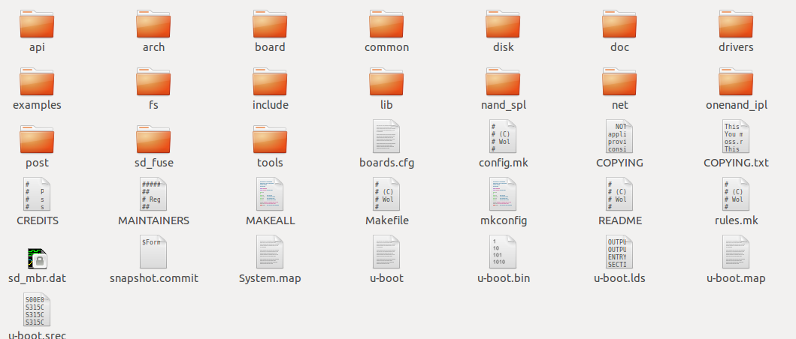
u-boot directory structure

Slide 8
u-boot directory structure
Arch
  Many types CPU : Arm, mips, i386 ...
Board
  Many types develop board : Samsung, ti, davinci ...
Tools
  Make Image (u-boot, linux ) or S-Record image tool
Drivers
  Some HW control code

Slide 9
u-boot directory structure
Common
  Major command and relation environment setting source code
Api
  Implement unrelated hardware code
nand_spl, onenand_ipl
  Related nand/onenand flash control
Example
  Standalone application

Slide 10
u-boot directory structure
Post
  Supply Power On Self Test function
Fs
  Supply file system : fat, jffs2, ext2, cramfs
Lib
  General public library : CRC32/16, bzlib, ldiv ..
Disk
  Supply disk driver and partition handling

Slide 11
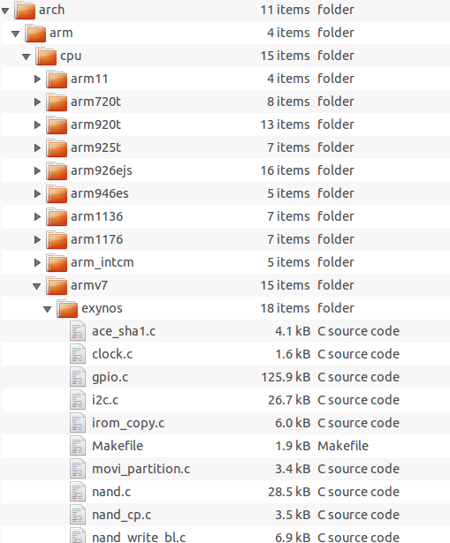
u-boot directory structure about tiny4412

Slide 12
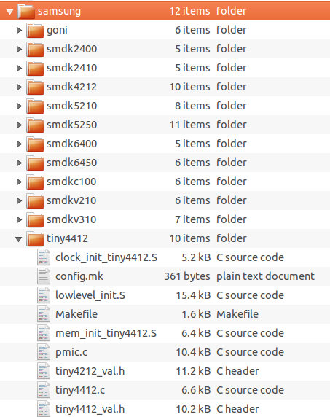
u-boot directory structure about tiny4412

Slide 13
u-boot directory structure about tiny4412
arch/arm/cpu/armv7/exynos/
  Samsung exynos CPU related
  Clock, i2c, irom, mmc, emmc ...
board/samsung/tiny4412/
  Tiny4412 EVB related
  Low level init, memory init, link script ...
Common
  Tiny4412 u-boot command related
include/configs/tiny4412.h
  Tiny4412 EVB build configure related

Slide 14
How to build u-boot
Clear
  #make distclean
Configure
  #make board_config <tiny4412_config>
Build
  #make -j4
Result of build
  u-boot : ELF format file
  u-boot.bin : raw data binary

Slide 15
Link Script
u-boot.lds
  board/samsung/tiny4412/u-boot.lds
  The link script will pack all into binary.
  The binary file will put in storage.
  The start address (.TEXT) can be modified.
CONFIG_SYS_TEXT_BASE
  board/samsung/tiny4412/config.mk
  Check u-boot.map

Slide 16
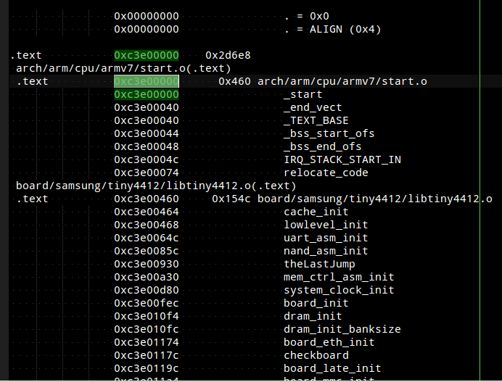
u-boot.map

Slide 17
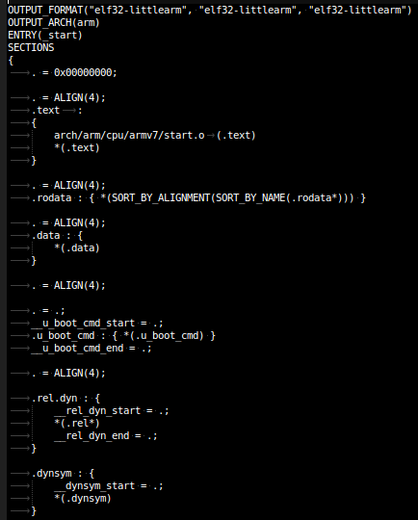
Link Script
arch/arm/cpu/armv7

Slide 18
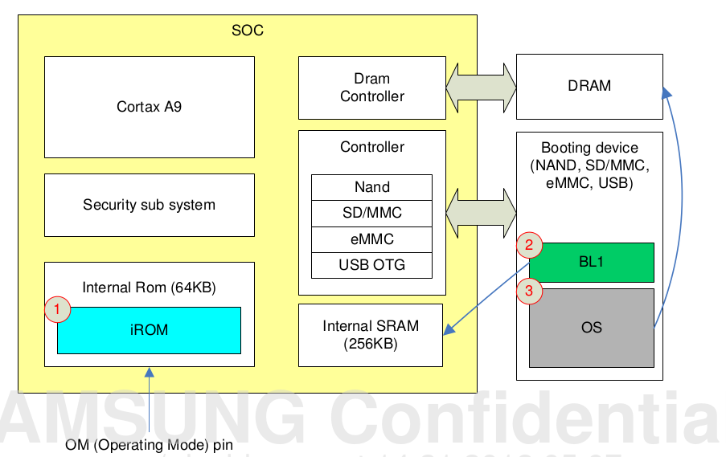
Exynos 4412 Booting Sequence

Slide 19
U-boot initialize sequence

Slide 20
U-boot start up sequence
set the cpu to
SVC32 mode
Set stack and
jmp to board_init_f
Jmp to _board
_init_r_ofs
Invalidate L1 I/D
Do relocate code
board_init_r @
Arch/arm/lib/board.cr
disable MMU
clear_bss
lowlevel_init
jump_2_ram

Slide 21
lowlevel_init
Check OM :
Read booting
information
System clock init
check reset status
Memory initialize
Sleep wakeup
reset?
SD/MMC or
eMMC boot
Load uboot to ram
Run in the RAM ?
wakeup_reset
board_init_f

Slide 22
board_init_f
basic arch cpu
dependent setup
display board info
setup stackpointer
for exeptions
board_early_init_f
configure available
RAM banks
Dram init banksize
env init
reserve TLB table
Display dram config
stage 1 init of
console
reserve memory for
LCD display
relocate_code
Display banner
reserve memory for
U-Boot code, data & bss
Print cpuinfo
reserve memory for
malloc() arena

Slide 23
relocate code
relocate_code
(addr_sp, gd, addr_moni)
jump to ram
_board_init_r_ofs
Set up the stack
board_init_r
(gd_t *id, ulong dest_addr)
copy code from SRAM to
DRAM
Do address offset
clear_bss

Slide 24
board_init_r
/************************************************************************
*
* This is the next part if the initialization sequence: we are now
* running from RAM and have a "normal" C environment, i. e.
* global data can be written, BSS has been cleared, the stack size in
* not that critical any more, etc.
*
************************************************************************
*/

Slide 25
board_init_r
board_init()
env_relocate()
interrupt_init()
main_loop()
serial_initialize()
stdio_init()
enable_interrupts()
mem_malloc_init()
jumptable_init()
Network card init
mmc_initialize()
api_init()
board_late_init()

Slide 26
Operating U-boot

Slide 27
Operating U-boot
Understand and use command
Understand and modify parameters
Run Application

Slide 28
Add Feature
Add command
  common/
Add driver
  driver
Add application
  example
boards.cfg

Slide 29
Add Command
How to create a command ?
Directory
  common/
    cmd_mmc.c, cmd_bootm.c, cmd_help.c
U_BOOT_CMD(name,maxargs,rep,cmd,usage,help)
  include/command.h

Slide 30
Add application
How to add a application
Directory
  example
Api
  Standalone
  arch/arm/config.mk
    STANDALONE_LOAD_ADDR

Slide 31
Add a driver
How to add a driver
Directory
  driver/
  drivers/gpio/s5p_gpio.c

Slide 32
Boot Linux kernel

Slide 33
Boot Linux kernel
Boot command
  Bootm
  common/cmd_boot.c
uImage
  Tool : mkimage
Linux kernel ATAG

Slide 34
uImage
tools/mkimage
Usage: tools/mkimage -l image
-l ==> list image header information
tools/mkimage [-x] -A arch -O os -T type -C comp -a addr -e ep -n name -d data_file[:data_file...] image
-A ==> set architecture to 'arch'
-O ==> set operating system to 'os'
-T ==> set image type to 'type'
-C ==> set compression type 'comp'
-a ==> set load address to 'addr' (hex)
-e ==> set entry point to 'ep' (hex)
-n ==> set image name to 'name'
-d ==> use image data from 'datafile'
-x ==> set XIP (execute in place)
tools/mkimage [-D dtc_options] -f fit-image.its fit-image

Slide 35
uImage
./mkimage
-A arm
-O linux
-T kernel
-C none
-a 60008040
-e 60008000
-d zImage
$output_name

Slide 36
How to jump to kernel
Use boot command
  common/cmd_bootm.c
  command entry
    int do_bootm (…)
    boot_os_fn *boot_fn;
do_bootm_linux(...)
  arch/arm/lib/bootm.c
kernel_entry(0, machid, bd->bi_boot_params);
  0
  Mach ID
  atag

Slide 37
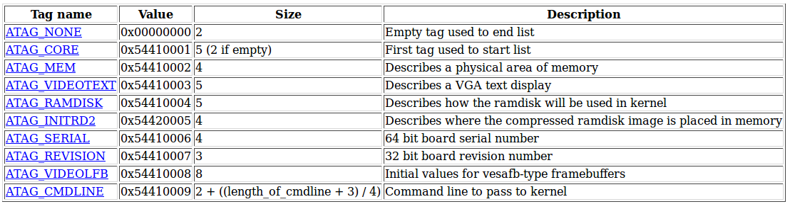
Linux Atag
Kernel parameters

Slide 38
Let's Exercise

Slide 39
Build u-boot
Clean
  #make distclean
modify configure
  include/configs/tiny4412.h
Do EVB configure
  #make tiny4412_defconfig

Slide 40
Download and boot kernel

